Slide 1


Got Organic Products?
Notes:
Instead of “got milk?” we are revitalizing the famous slogan to “got organic products?”. Hi, my name is Estefani, and today I will present a business scenario and the models used to best help the superstore with their business problem involving organic products.

Slide 2

Business Problem
1. Develop the profile of A customer who will purchase
2. Identify Key factors to customer’s purchasing organic products
Notes:
The business problem at hand is that the supermarket is now offering a new line of organic products and we are seeking to answer two questions:
The first, which customers are most likely to purchase these products?
Secondly, we need to develop a profile of the typical customer that purchases organic products?
Except that is not all, they also want to know whether a customer that purchases organic products spends more (or less) on average than other customers. In identifying this, we can see if the additional costs of stocking organic products is valuable to the superstore.

Slide 3

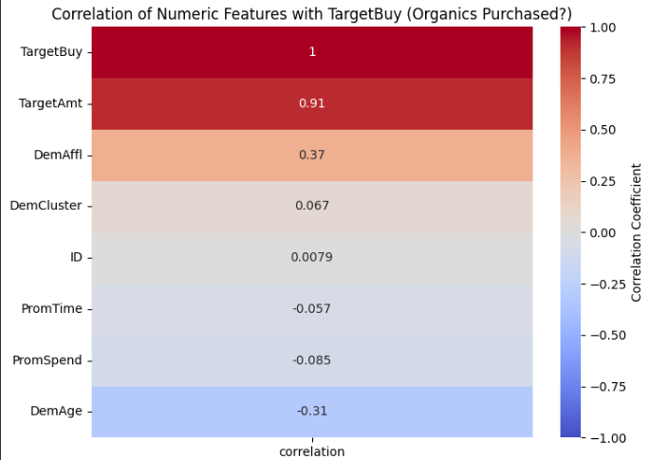

Exploratory analysis
Notes:
Before we developed models to help answer the questions, we dove into exploratory analysis.
We had various missing data from customer profiles and opted to drop all nulls; since most of the variables were specific to each customer such as their affluence grade. So, imputing a value to fill those gaps would not portray the accurate identification of the customer who would most likely purchase organic products.
Moving on, during the exploratory analysis we wanted to investigate how these variables correlated to one another especially the target variable at the top named “TargetBuy.” So, we developed a heat map to help identify highly correlated variables. As you can see on the slide, that’s the heat map using only numerical data, where TargetBuy has a max correlation of 1 since it is being measured to itself. Yet, right below this variable there is Target Amount [TargetAmt] that is 91% correlated to TargetBuy. Here, Target Amt is the number of organic products purchased, so to avoid multicollinearity on our models we will remove this variable for further model development as it can cause issues in the model’s stability and interpretability since its so highly correlated to our target variable.

Slide 4
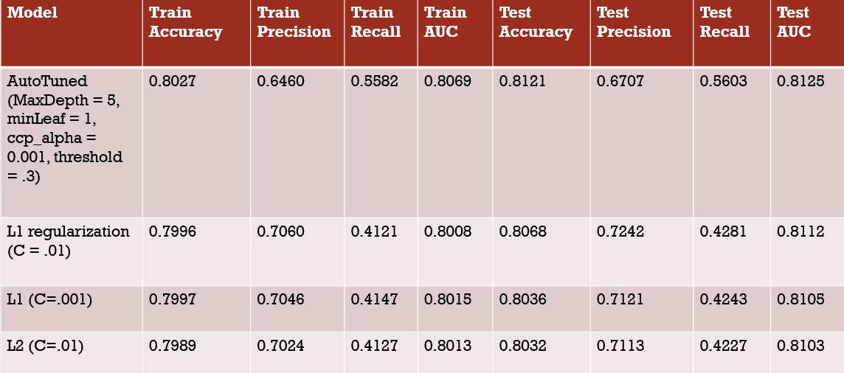
Model table
Notes:
So, after completing the exploratory analysis we proceeded to create four models as shown in this table. There might be some terms on the screen that may not make much sense so I will synthesize the information.
The accuracy in a model means that out of all the data, how well did the model accurately predict if a person would or would not buy an organic product?
The precision means that when the model predicts a customer will buy an organic product what is the percentage that it is usually correct.
Finally, the recall means that out of all the customers that bought organic products, the model was only able to correctly predict that percentage.
So now looking back at the model table, we can focus solely on the test portion to truly see how the model did against new data, this will be the last four columns to the right. The area under the curve for all models remained in the same range. This is good because the AUC identifies how well the model can discriminate between customers that will buy organic products and those that will not.
The precision dips for the first model on the table. However, another observation is that the recall is terrible for all logistic models which are the last three models. This means that out of all the customers that did buy organic products, the last three models were only able to accurately predict 42-43%. Yet, the first model has the highest of all models, with a recall score of 56%. That said, we made the decision to go with the first model since all its scores remained consistent across all fields and we preferred a well-rounded model than a model that only has a high score for precision.

Slide 5
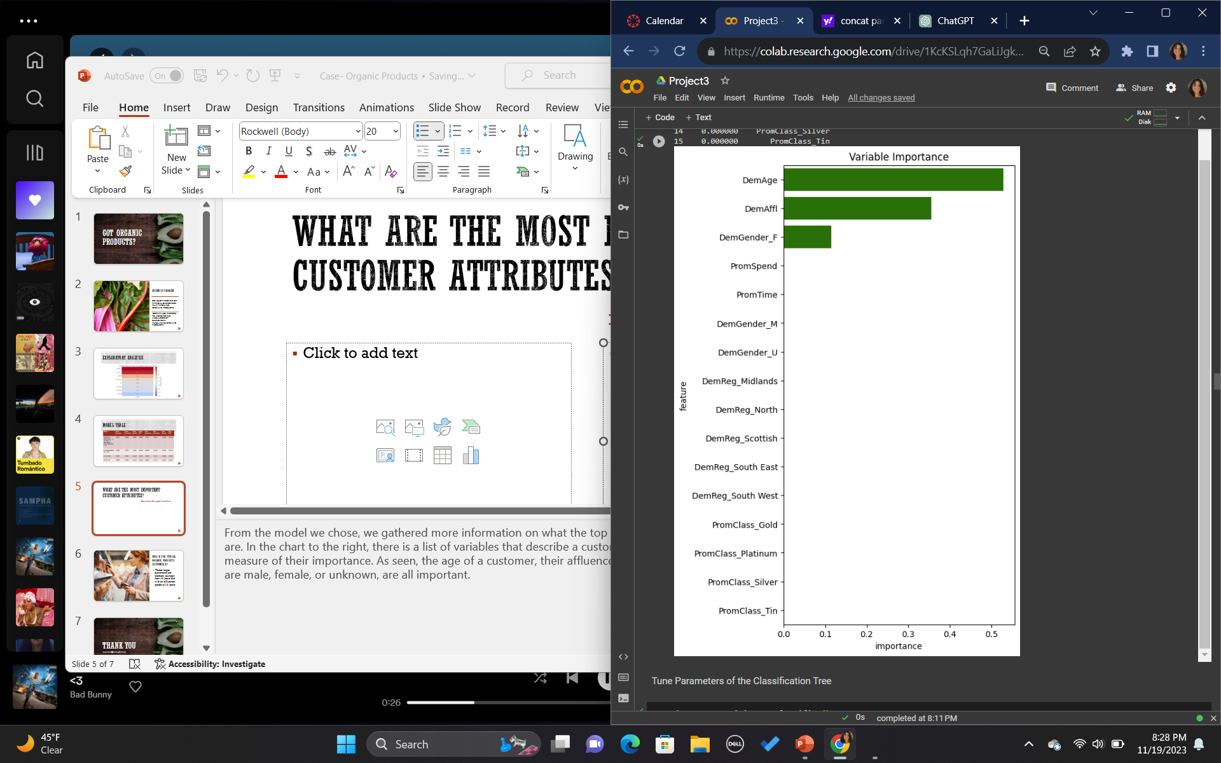
What are the most important customer attributes?
Key factors the model identified
Age, in years
Affluence grade on a scale of 1-30
If that person identifies as a female
Notes:
From the model we chose, we gathered more information on the most important customer attributes.
In the chart to the right, there is a list of variables that describe a customer such as their age and gender. On the bottom is the measure of their importance from a scale of 0-0.6. As you can see, the customer’s age, affluence grade which is a scale used to describe the life stage at which individuals or households attain a certain level of affluence, and whether a customer identifies as a female, all rank as the best indicators that a person will most likely choose to buy an organic product from the superstore.
Meanwhile, all other variables that were passed to the model have an importance of 0. But now that we know these are important attributes of the customer we are seeking to target, can we narrow the scope to get a more specific identification of that customer who would buy an organic product from our store? …..

Slide 6

Who is the typical organic products customer(s)?
These target customers are younger than 45 and have a
Notes:
The answer is yes! The audience we are attempting to marketize for are customers who are younger than 45 and have an affluence grade more than 15 meaning that they are not kids, but they could most likely be transitioning into adulthood, getting ready to try new things as they establish their careers. These customers will mostly likely have been trying organic products as they shop for themselves and want to ensure they know exactly what's going into their bodies.

Slide 7
Recommendations to increase sales?
Strategize the marketing to fit the customer description
01
Avoid assumptions
02
Continue collecting data
03
Notes:
Now, how can we help increase organic food sales?
For one, it would be best to strategize the marketing for organic products given this new information, where the target is narrowed to younger people with a stable life where they can afford to pay more for their organic products. Perhaps we could assess the current population coming to the superstore and see if this new demographic of an ideal organic consumer that the model produced is prominent in this superstore.
It is important to mention that prior assumptions such as, “does a customer’s loyalty status make them more likely to purchase organic products?” are not correct assumptions to make considering the bar chart of important customer attributes. Though, it might seem logical to assume a certain attribute could be linked to higher sales, it also could lead to a dead end. To make more data driven decision, it would be most useful to take advantage of the customer attributes that were listed as significant from the model.
Lastly, it is also important to note that this model is not perfect, and keeping this model as long-term model is not ideal. The customer demographic of organic consumers is not stationary, and neither should this model. I would suggest to continue including more data outside of the variables already given. It was unfortunate to see Target Amount be removed from our model, but data collection can really help us produce a more precise model in the future.

Slide 8
Thank you
Questions?
Notes:
Thank you so much for your time! I hope this was useful information to help improve organic product sales.
I will now take any questions you may have.

